Slide 1
Evaluación y Logging en Aplicaciones de IA
Mejores Prácticas y Herramientas

Slide 3






About us
Luis Mañez
Chief Architect @ ClearPeople
Co-founder @ RocketMind Academy
MS MVP M365 Development
@luismanez
Ruben Toribio
@luismanez
linkedin.com/in/luismanez
M365 Architect / IA Developer @ DNV
Co-founder @ RocketMind Academy
@Rtoribiog
@Rtoribiog
linkedin.com/in/rubentg

Slide 4
Agenda
Introduction
GenAIOps
Logging Strategies
OOTB VS Custom
Demo Logging
Evaluation Methods and Strategies
Introducing Azure Evaluation
eShopSupport Evaluator
Micronaire

Slide 5
Importance of Evaluation in Generative AI
Introduction to GenAIOps
Extending MLOps practices specifically for generative AI models.
Why GenAIOps Matters
Addresses unique challenges in deploying and managing generative AI.
Key Objectives
Ensure efficient development, deployment, and maintenance of generative AI applications.
https://learn.microsoft.com/en-us/azure/ai-services/openai/monitor-openai-reference

Slide 6
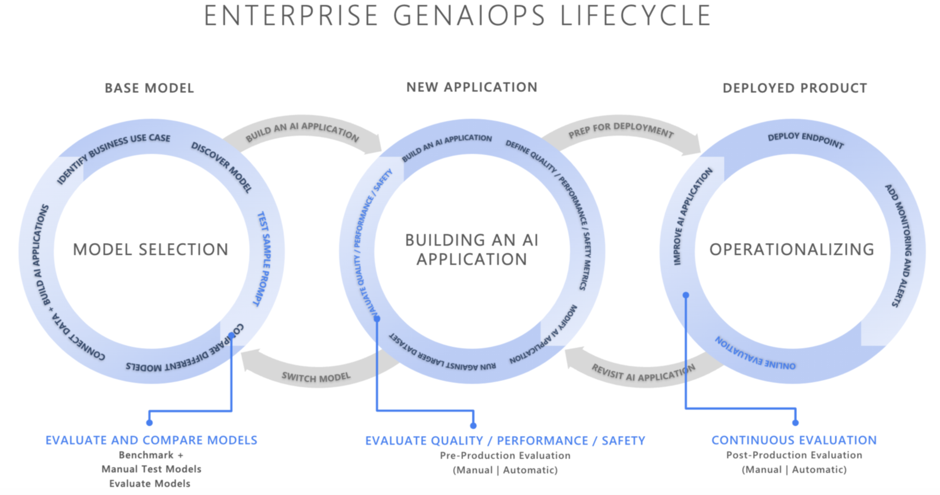
GenAIOPS LifeCycle

Slide 7
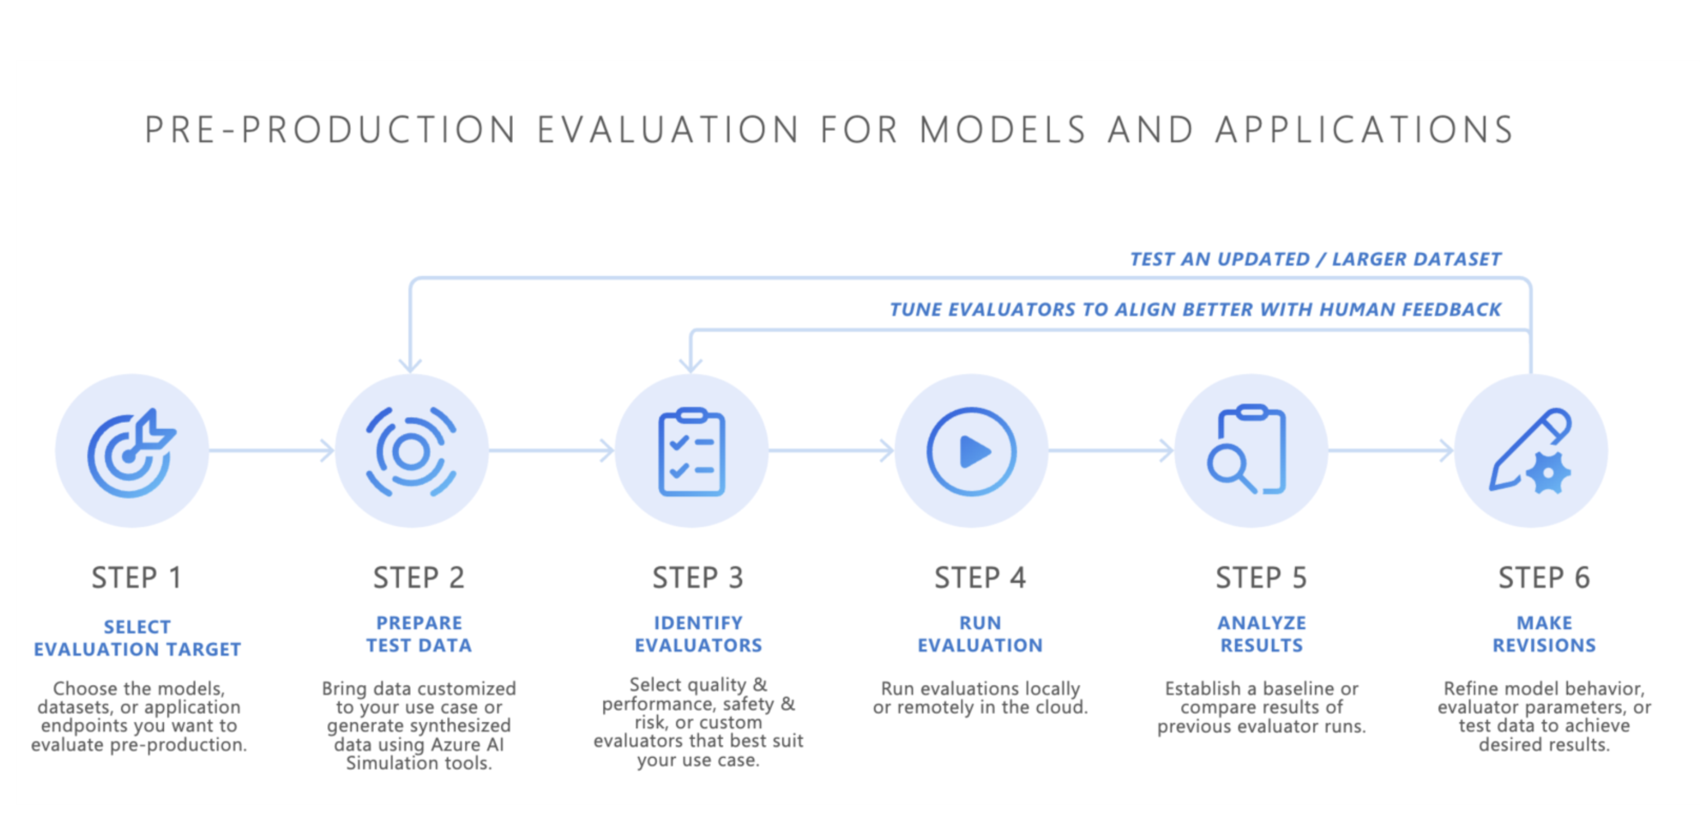
GenAIOPS LifeCycle

Slide 8
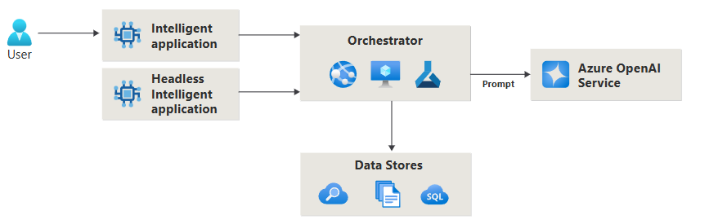
Importance of Evaluation in Generative AI
Fine-Tuning Generative AI Models
Customizing pre-trained models to specific tasks or domains.
Enhances model performance and relevance.
Retrieval-Augmented Generation (RAG)
Combines model outputs with external knowledge bases.
Provides up-to-date and contextually accurate responses.
Benefits
Improves accuracy and utility of AI-generated content.
Reduces model hallucinations and enhances groundedness.
Prompt engineering architecture
https://learn.microsoft.com/en-us/azure/ai-services/openai/monitor-openai-reference

Slide 9
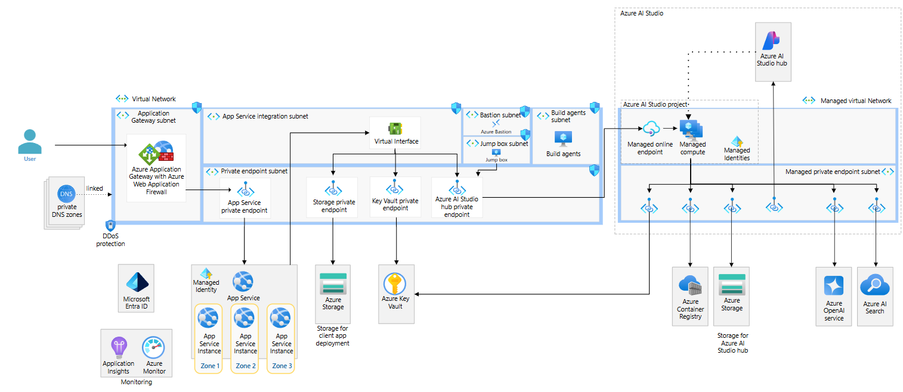
Architecture

Slide 10
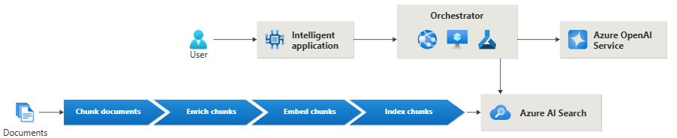
Importance of Evaluation in Generative AI
Inner Loop: Development Phase
Activities:
Rapid experimentation and prototyping.
Fine-tuning models and adjusting prompts.
Goal:
Quickly iterate to improve model performance.
Outer Loop: Operational Phase
Activities:
Deployment to production environments.
Continuous monitoring and maintenance.
Goal:
Ensure models perform reliably at scale and adapt over time.
Retrieval-augmented generation (RAG) architecture

Slide 11
Importance of Evaluation in Generative AI
Automation and CI/CD Pipelines
Streamline deployment processes for generative models.
Automate testing, integration, and delivery.
Monitoring and Feedback Loops
Track model performance metrics like relevance, coherence, and groundedness.
Use feedback to inform inner loop iterations.
Data Management
For Fine-Tuning:
Collect and preprocess domain-specific datasets.
For RAG:
Maintain and update external knowledge bases.

Slide 12
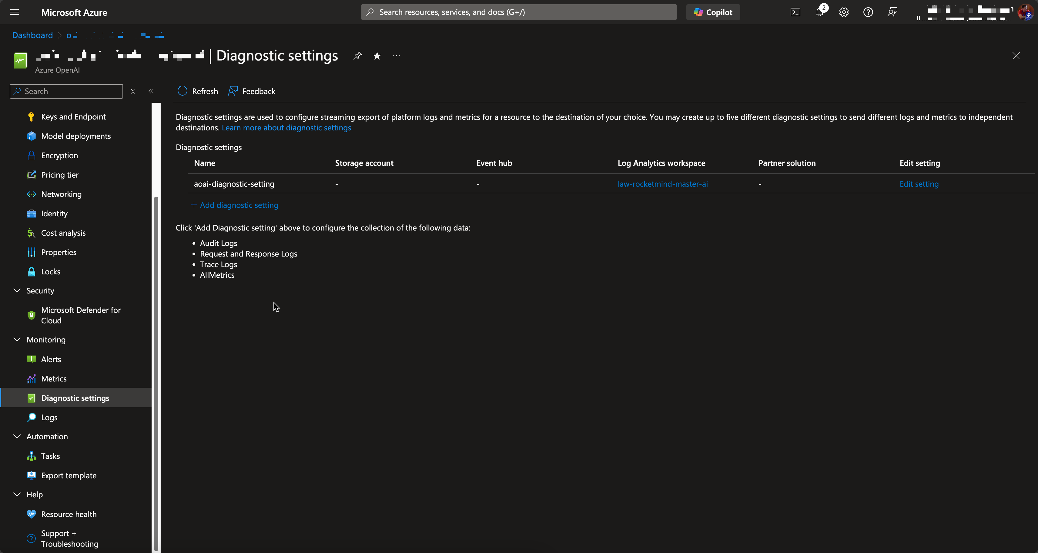
Monitoring Azure OpenAI – OOB Options

Slide 13
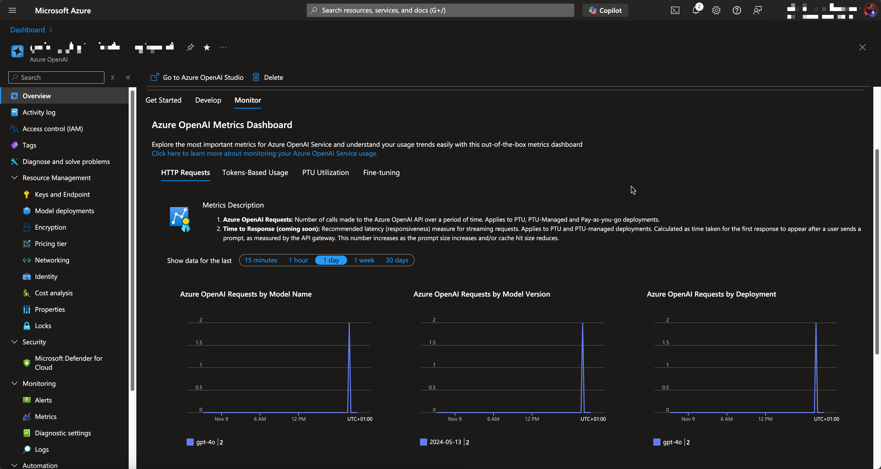
Monitoring Azure OpenAI – OOB Options

Slide 14
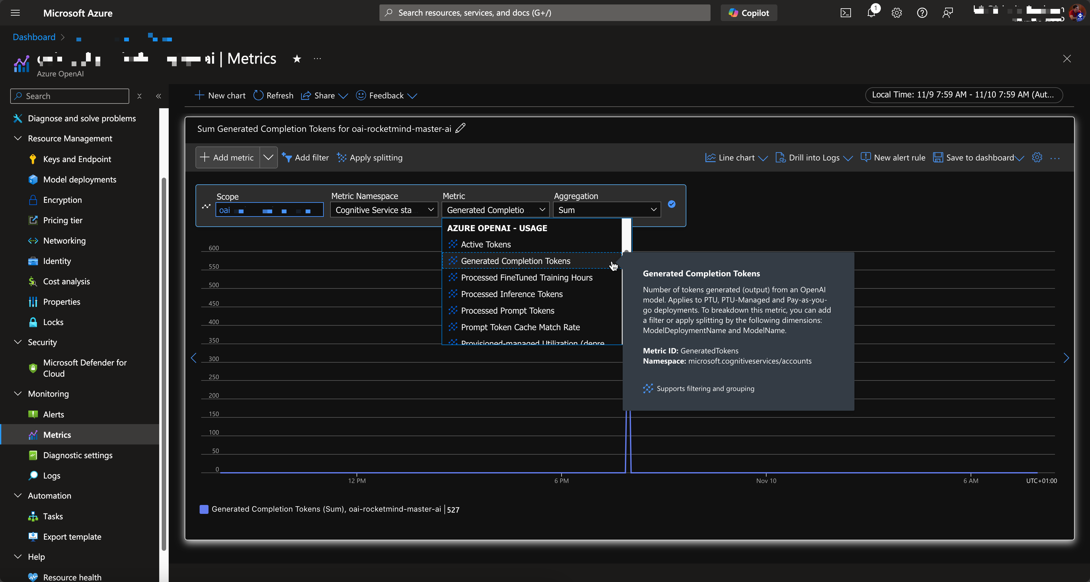
Monitoring Azure OpenAI – OOB Options

Slide 15
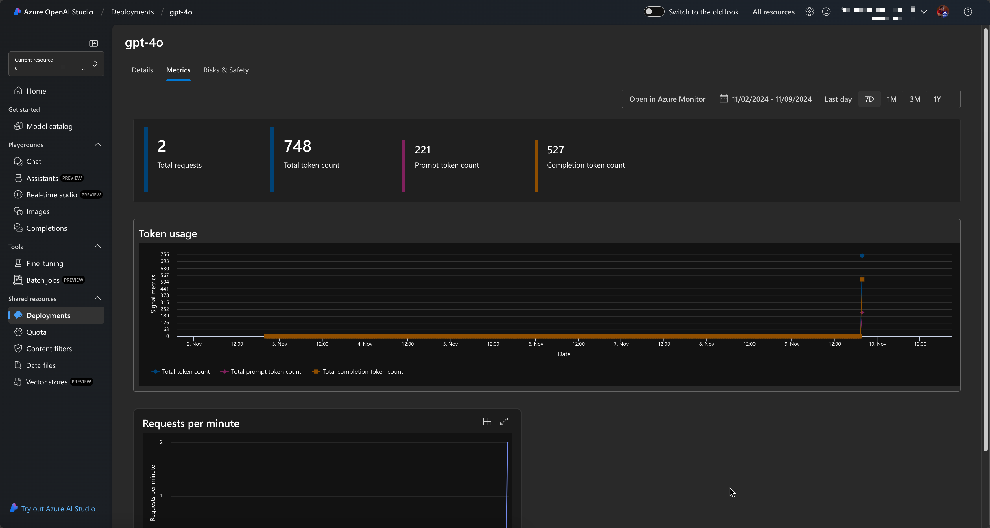
Monitoring Azure OpenAI – OOB Options

Slide 16
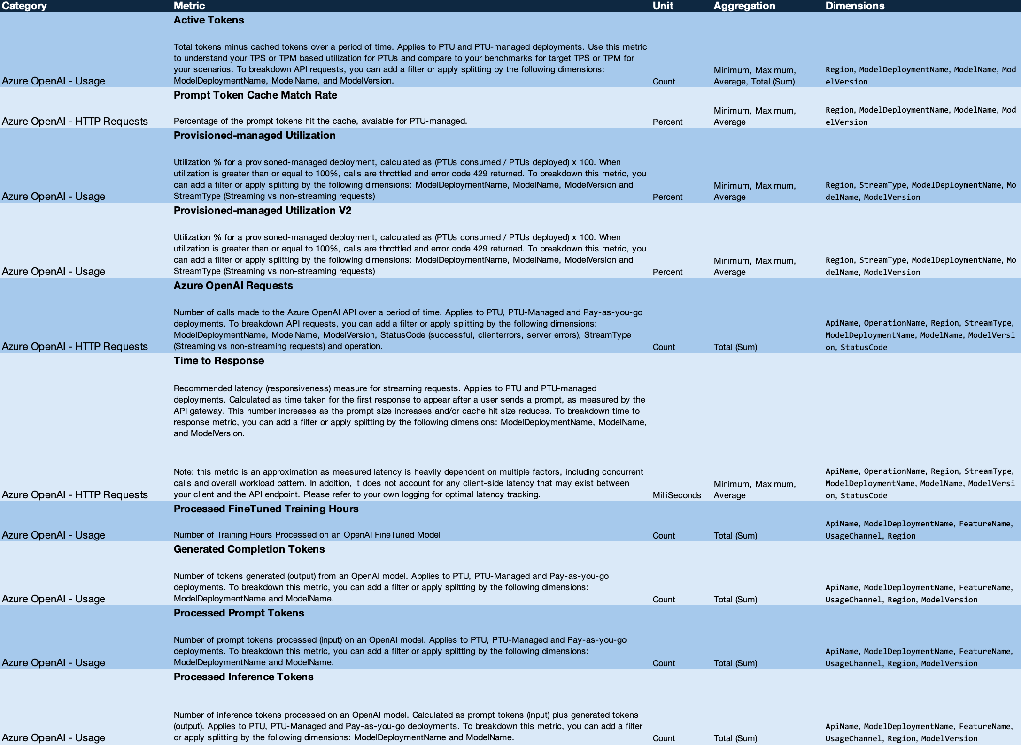
Monitoring Azure OpenAI – OOB Options
https://learn.microsoft.com/en-us/azure/ai-services/openai/monitor-openai-reference

Slide 17
Understanding Evaluation in AI
What is Evaluation?
The systematic process of assessing AI models
Ensures models meet desired performance criteria
Purpose of Evaluation
Validate model outputs
Enhance reliability and user trust
Guide iterative improvements
https://learn.microsoft.com/en-us/azure/ai-services/openai/monitor-openai-reference

Slide 18
Challenges in Evaluating Generative AI
Subjectivity
Difficulty in assessing creative or open-ended outputs
Dynamic Outputs
Variability in responses to similar inputs
Complex Evaluation Metrics
Need for specialized metrics beyond traditional accuracy
Resource Intensive
Requires time and expertise to conduct thorough evaluations
https://learn.microsoft.com/en-us/azure/ai-services/openai/monitor-openai-reference

Slide 19
Core Evaluation Metrics
Groundedness
Evaluates how well the AI model's generated answers are anchored in the provided source data or user-defined context. Higher groundedness indicates that the responses closely reflect the information from the original material.
Relevance
Measures the degree to which the AI-generated responses are pertinent and directly related to the given queries. A higher relevance score means the answers effectively address the user's questions.
Coherence
Assesses the logical flow and natural progression of the generated content. Higher coherence signifies that the output reads smoothly, makes logical sense, and resembles human-like communication.
Fluency
Determines the grammatical accuracy and language proficiency of the AI's responses. Higher fluency reflects fewer grammatical errors and more polished, natural-sounding language.
Retrieval Score
Measures how closely the documents or information retrieved by the model align with the user's queries. A higher retrieval score indicates that the retrieved content is highly relevant to the question posed.
Similarity
Evaluates the likeness between the AI-generated response and the ground truth or reference sentence. A higher similarity score means the AI's output closely matches the expected answer in content and meaning.
https://learn.microsoft.com/en-us/azure/ai-services/openai/monitor-openai-reference

Slide 20

Types of Q&A Data
Manual (Human-Generated)​
Created by experts or annotators​
Synthetic (AI-Generated)​
Produced by AI models or algorithms

Slide 21
Manual Q&A Generation
Advantages
High Quality
Human intelligence ensures relevance and correctness
Contextual Understanding
Captures nuances and subtleties
Reliability
Trusted for critical applications
Challenges
Resource Intensive
Time-consuming and costly
Scalability Issues
Potential for Human Biases

Slide 22
Synthetic Q&A Generation
Advantages
Scalability
Can generate large datasets rapidly
Cost-Effective
Reduces reliance on human labor
Diversity
Introduces variations that might not be captured manually
Challenges
Quality Control
Risk of generating incorrect or irrelevant content
Lack of Deep Understanding
Propagation of Model Biases

Slide 23
Tools and Frameworks for Evaluation
Azure Evaluation & Promptflow -> Python & UI
Tool for prompt engineering and evaluation
eShopSupport Evaluator -> .Net
A practical example of an AI evaluator in a .NET application
Micronaire Project -> . Net
A Microsoft hackathon project utilizing Semantic Kernel for content generation and evaluation

Slide 24
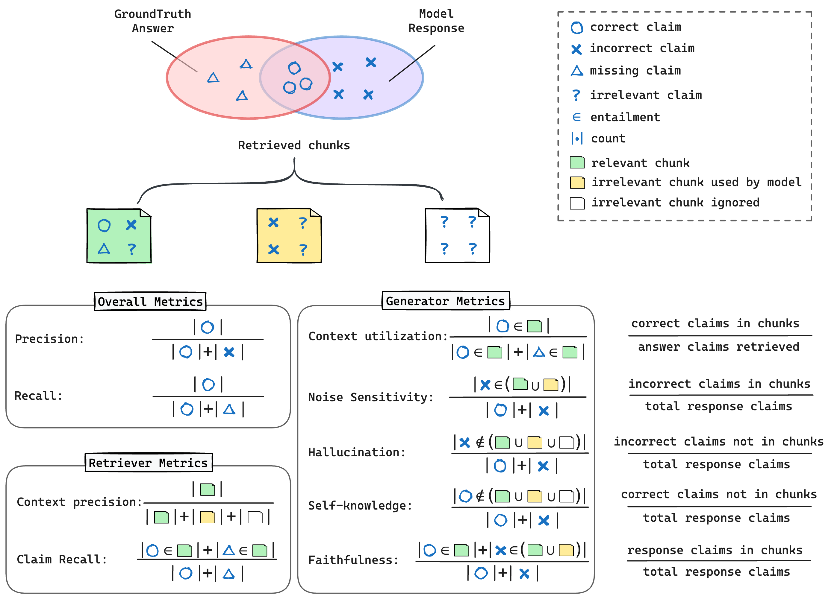
Tools and Frameworks for Evaluation
Best in market -> Python
Ragas
RAGChecker
Comet

Slide 25
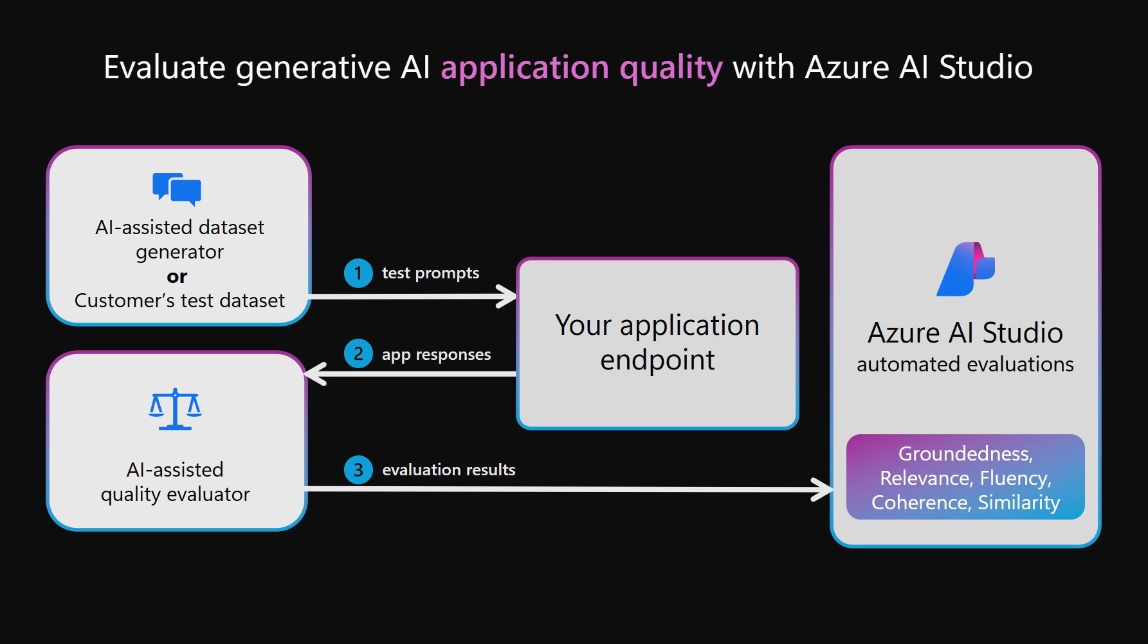
Introducing Azure Evaluation & Promptflow
What is Promptflow?​
A visual tool for designing, testing, and evaluating prompts in Azure Machine Learning​
Key Features​
Visual workflow interface​
Supports multiple language models​
Customizable evaluation metrics​
Benefits​
Accelerates prompt development​
Enhances evaluation efficiency

Slide 26
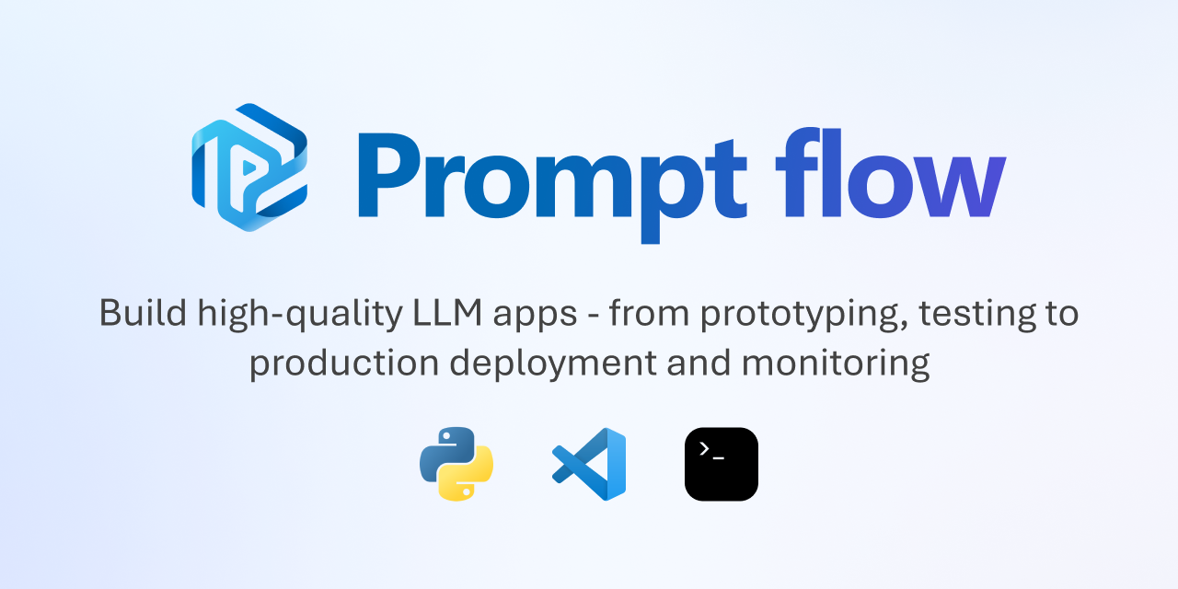
Tools and Frameworks for Evaluation
Prompt Engineering​
Crafting and refining prompts to elicit desired model outputs​
Evaluation Workflow​
Iterative testing and refinement of prompts​
Integration​
Compatible with Azure OpenAI Service and other LLMs​
Collaboration​
Share and iterate on prompts within development teams

Slide 27
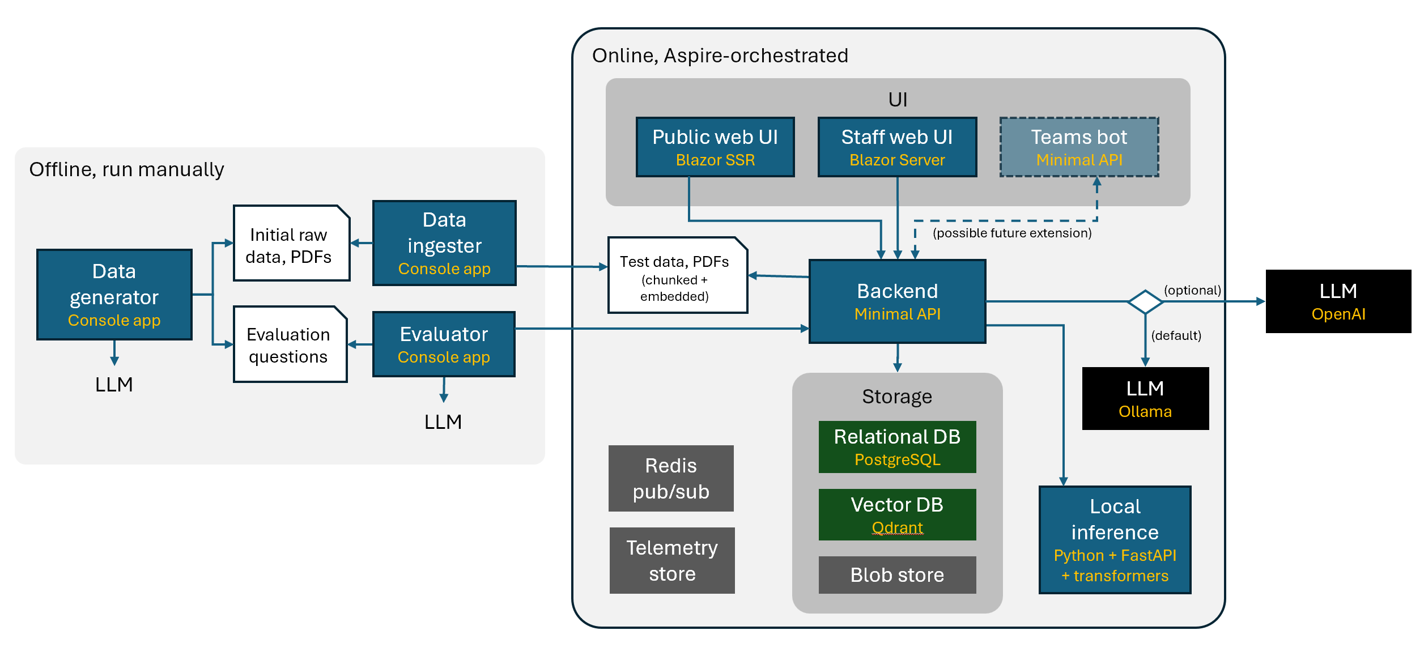
eShopSupport Evaluator Project
Overview​
A .NET demo application focusing on customer support automation​
Purpose of the Evaluator​
Assessing AI-generated responses to customer queries​
Key Features​
Real-time evaluation of responses​
Feedback loop for continuous improvement​
GitHub Repository​
eShopSupport Evaluator

Slide 28
eShopSupport Evaluator Project
Components of the System​
Input Processor: Manages incoming customer queries​
AI Response Generator: Creates replies using AI models​
Evaluator Module: Evaluates the quality of AI responses​
Workflow Process​
Customer submits a query​
AI generates a response​
Evaluator checks response for relevance and accuracy​
Response is sent back to the customer or flagged for review

Slide 29

Introducing Micronaire Project
What is Micronaire?​
A Microsoft hackathon project utilizing Semantic Kernel​
Project Goals​
Streamline content generation​
Implement automated evaluation mechanisms​
Key Features​
Intelligent prompt management​
Integration with AI models for content creation​
GitHub Repository​
Micronaire Project

Slide 30
Introducing Micronaire Project
Components​
Semantic Kernel Integration: Utilizes pre-built AI components​
Content Generation Module: Creates AI-generated content​
Evaluation System: Assesses content quality and relevance​
Workflow​
User defines content requirements​
AI generates content using Semantic Kernel​
Evaluation system assesses the content​
Content is refined based on evaluation feedback

Slide 31
Summary and Best Practices
GenAIOps extends traditional MLOps for the complexities of generative AI.
Fine-tuning and RAG are essential for enhancing model outputs.
Inner and outer loops enable efficient development and reliable deployment.
Best Practices
Adopt Automation:
Use tools to automate both inner and outer loop processes.
Continuous Evaluation:
Regularly assess models using metrics like groundedness and relevance.
Collaborative Approach:
Encourage cross-functional teams to work closely throughout the model lifecycle.
Next Steps
Start integrating GenAIOps practices into your AI projects.
Leverage available tools and frameworks to support these processes.

Slide 32


RocketMindAcademy.es
Cursos de Copilot & Azure AI
Bonificables por fundae
Para Equipos en empresas o individuales
Clases en directo
Certificado finalización

